Slide 1
Implementation and Evaluation of a Software Defined Radio Based Radiometer
Matthew E. Nelson
Iowa State University
Electrical and Computer Engineering

Slide 2
Acknowledgements
POS Committee
Dr. Phillip Jones, Dr. Brian Hornbuckle, Dr. John Basart
Additional Support
Dr. Mani Mina
Special Thanks
My wife Jennifer and my family for their support

Slide 3
Table of Contents
Introduction
Related Works
Background
Radiometer and SDR Basics
Implementation of a SDR-based Radiometer
Experimental Setup and Results
Example Usage Scenario
Closing

Slide 4
Introduction
Introduction
Related Works
Background
Implementation
Experimental Results
Example Usage Scenario
Closing
The goal of this presentation is to present my work in using software defined radio (SDR) technology to develop a radiometer that has performance on par with that of traditional radiometer. In addition to demonstrating a SDR-based radiometer can achieve similar performance, in terms of sensitivity and stability, as a traditional radiometer, it is shown that the inherent flexibility of SDR technology allows implementing functionality beyond what a traditional radiometer typically provides.
This thesis looks to explore the following questions:
Can we use a SDR to recreate a radiometer in software?
If so, what performance can we get from the system?
Can we create a low cost SDR Radiometer that is effective?
What benefits do we obtain by using a SDR Radiometer?

Slide 5
About the thesis
Introduction
Related Works
Background
Implementation
Experimental Results
Example Usage Scenario
Closing
Motivation:
Radiometry is used in a number of applications including:
Soil Moisture and Ocean Salinity (SMOS) satellite
Image courtesy of ESA
NRAO VLA
Image courtesy of NRAO/AUI
Notes:
SMOS was launched in November 2nd, 2009 by European Space Agency (ESA). It measures both soil moisture and ocean salinity using a radiometer at 1.4 GHz using a Microwave Imaging Radiometer with Aperture Synthesis (MIRAS). It uses both Vertical and Horizontal polarization.
The National Radio Astronomy Observatory is located in New Mexico. The VLA there uses cryogenics to keep the RXs cool. The signal is digitized and sent via fiber optics to a super computer to process the data.

Slide 6
Related Works
Introduction
Related Works
Background
Implementation
Experimental Results
Example Usage Scenario
Closing
Digital Radiometers
Radio Frequency Interference (RFI) Mitigation
Kurtosis
Polarization Signature
Detection
Mitigation
Mechanical Filters
Hybrid
A mix of analog and digital components
Often digitizes after power detection
Direct Sampling
Samples directly at the frequency of interest
Uses digital signal processing to extract power information
Notes:
Three areas of related works – Digital Radiometers, RFI and SDR-based Radiometers
Hybrid = Digitizes some part of the signal, usually with an ADC and after the square-law detector

Slide 7
Related Works
Introduction
Related Works
Background
Implementation
Experimental Results
Example Usage Scenario
Closing
Software Defined Radio Based Radiometers
Shirleys Bay Radio Astronomy Consortium
Grand Valley State University
Notes:
Marcus is the Principal Investigator at SBRAC and also a contributor to the radiometer branch in GNURadio. Although this branch is no longer maintained, he still answers questions about using radiometers with GNURadio. SBRAC has successfully used this configuration to obtain radio astronomy data by looking at the hydrogen line at 1420.4058 MHz. It was this software branch that was used as the base for the GNURadio program that was used in this thesis.
In 2013, the University of Illinois and Grand Valley State University built a software defined radio based radiometer to listen to emissions from Jupiter. They custom built the hardware portion of their software defined radio using an Analog Devices analog to digital converter (AD9460) and a Xilinx (Spartan-3E-500) FPGA. They also implemented a RF front end to filter and amplify the incoming RF signal. The software side of their radiometer was composed of: 1) GNURadio for low-level communications with their software defined radio and, 2) Python script and WxGUI to implement a higher level user interface. The students reported that their SDR based radiometer worked well at a low price point. One aspect that differentiates the work in the thesis from Grand Valley State University’s work is that they build their own custom hardware for their software defined radio, while in this work off the shelf components were used with an aim of making radiometers more wildly accessible to the research community.

Slide 8
Related Works
Introduction
Related Works
Background
Implementation
Experimental Results
Example Usage Scenario
Closing
Contributions
Development of a software defined radio-based radiometer
Python based scripts for analyzing data generated by the radiometer
A Radio Frequency Interference (RFI) mitigation technique implemented using software defined radio technology

Slide 9
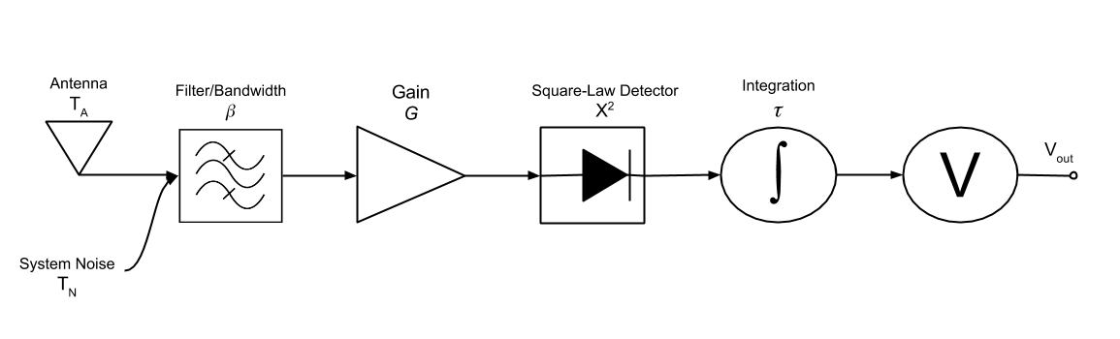
SDR and Radiometer Basics
Introduction
Related Works
Background
Implementation
Experimental Results
Example Usage Scenario
Closing
There are six stages common to all radiometers:
Source
Bandwidth
Amplification
Power detection
Data smoothing
Output
Notes:
A radiometer is a device designed to measure thermal electromagnetic emission by a material media. This electromagnetic emission is the thermal noise of the object and can be correlated to the physical temperature of the object.
An ideal radiometer would only measure this noise temperature. However, a real radiometer has additional noise added.
The primary goal of a radiometer is to measure power. While that statement sounds easy, there are in fact many factors that go in to how well a radiometer can measure the power it sees. A better statement would be that a radiometer’s primary goal is to accurately measure power within a certain degree of accuracy. In order to accurately and within a high degree of precision measure power, a radiometer must take into account various factors such as the system noise, the bandwidth of the signal and the stability of the system as a whole.

Slide 10
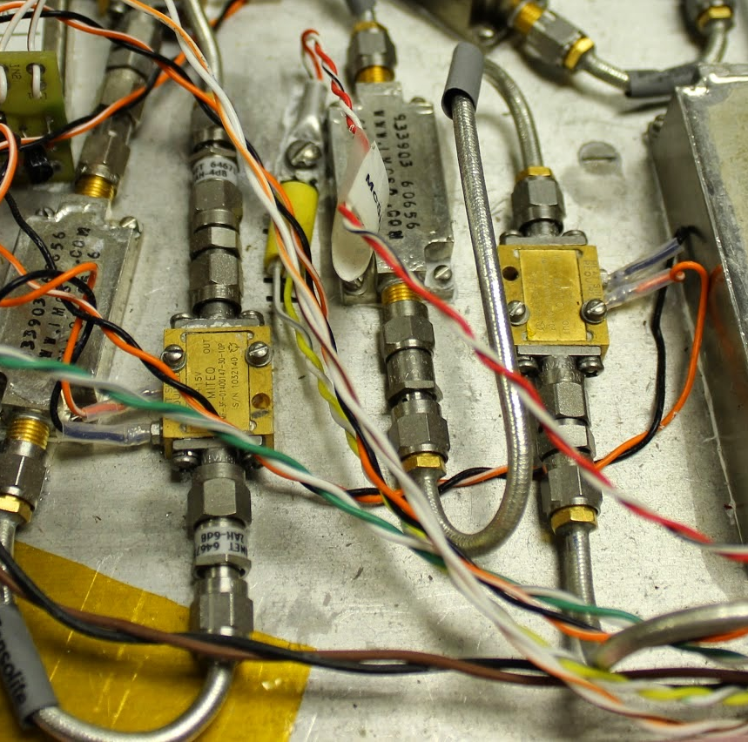
SDR and Radiometer Basics
Introduction
Related Works
Background
Implementation
Experimental Results
Example Usage Scenario
Closing
Power measurement
The key to the performance of a radiometer is to minimize noise generated internally while amplifying the noise generated from the source.
All components generate additional noise
Low Noise Amplifiers (LNAs) are the largest contributors
Notes:
To measure power we begin with the noise signal coming from the antenna. Our antenna is assumed to be looking at our target of interest and it is assumed that we can relate the antenna noise to the noise from the source. It is often easier to refer to this noise as the brightness temperature. Therefore the brightness temperature of the source can be related to the brightness temperature at the antenna. We will refer to this brightness temperature as TA

Slide 11
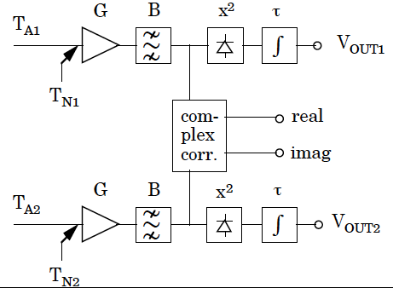
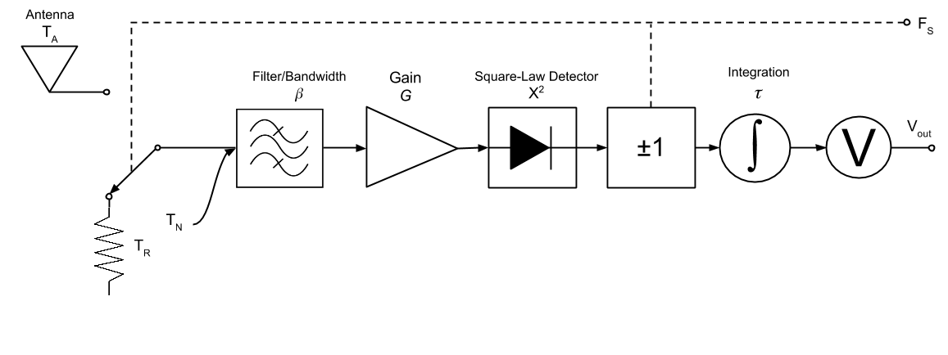
SDR and Radiometer Basics
Introduction
Related Works
Background
Implementation
Experimental Results
Example Usage Scenario
Closing
Compensating for stability
Notes:
The antenna itself also adds noise. Our greatest contributor to noise is from the LNAs. However mismatches in the RF chain and other factors can also increase this noise. This noise covers up or obscures the noise that we are interested in so we want to keep this to a minimum.

Slide 12
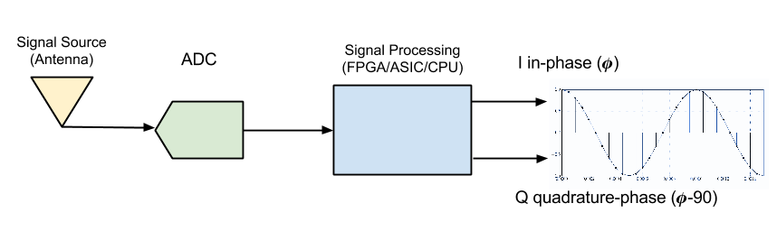
SDR and Radiometer Basics
Introduction
Related Works
Background
Implementation
Experimental Results
Example Usage Scenario
Closing
A software defined radio is a device that digitizes a received RF signal as soon as possible, and processes the digital representation of the signal using digital signal processing

Slide 13
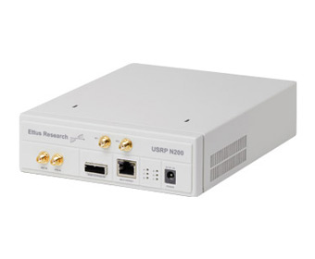
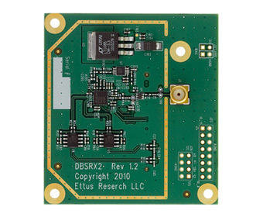
SDR and Radiometer Basics
Introduction
Related Works
Background
Implementation
Experimental Results
Example Usage Scenario
Closing
Hardware Platform
Dual 14-bit ADC
25 MHz bandwidth per channel
Modular daughter-board system
Notes:
Software defined radios have been used in a number of applications, but usually related to communication systems. Changes to modulation and encoding/decoding is very easy for a SDR and this is why SDRs have grown in recent years. Use in remote sensing applications, as far as I know, is a relatively new application of SDRs.

Slide 14
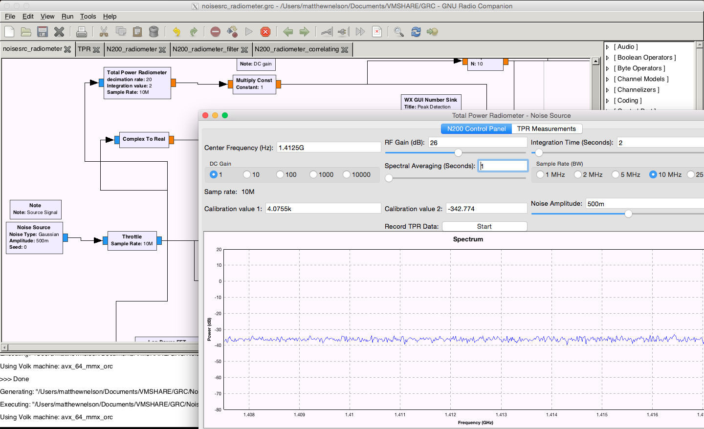
SDR and Radiometer Basics
Introduction
Related Works
Background
Implementation
Experimental Results
Example Usage Scenario
Closing
GNURadio and GNURadio Companion
GNURadio
Open Source
Excellent hardware support
GNURadio Companion
Drag and Drop
Rapid GUI development
Fast and Flexible
Easy to expand
Python/C++
Notes:
Filtering can be done by limiting the sampling rate of the SDR, but we can also add additional filtering if desired.

Slide 15
SDR-Based Radiometer Implementation
Introduction
Related Works
Background
Implementation
Experimental Results
Example Usage Scenario
Closing
Implementation of a Software Defined Radio Based Radiometer
Hardware Requirements
Software Requirements
Bandwidth 20 MHz
1400 - 1425 MHz
$$NEΔT=1 K$$
𝑁𝐸Δ𝑇=1 𝐾
Easy to use
Easy to modify
Notes:
NEAT is really determined more by the LNAs than the N200

Slide 16
SDR-Based Radiometer Implementation
Introduction
Related Works
Background
Implementation
Experimental Results
Example Usage Scenario
Closing
Mapping traditional radiometer to SDR-Based Radiometer – Power Detection
Analog
SDR
Square the magnitudes
Diode operating in the Square-Law region
Notes:
The block shown is the TPR block we used in GNURadio. This combines the total power measurement and integration and low-pass filter into one block that we can call in other programs.

Slide 17
SDR-Based Radiometer Implementation
Introduction
Related Works
Background
Implementation
Experimental Results
Example Usage Scenario
Closing
Mapping traditional radiometer to SDR-Based Radiometer – Data Smoothing
Analog
SDR
Infinite Impulse Response Filter
Decimation
Integrator a.k.a. Low Pass Filter
Notes:
IIR filter
Decimation to reduce data size

Slide 18
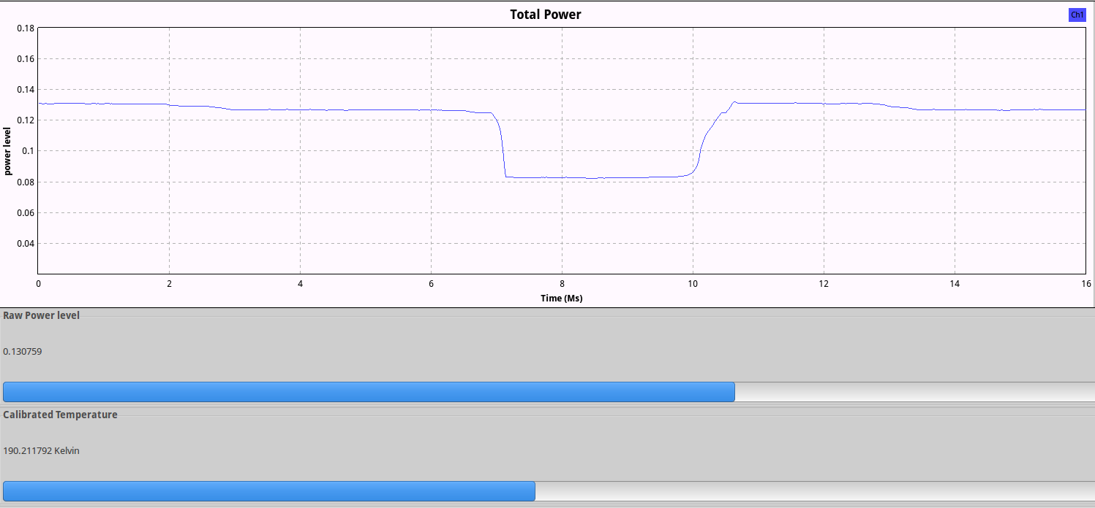
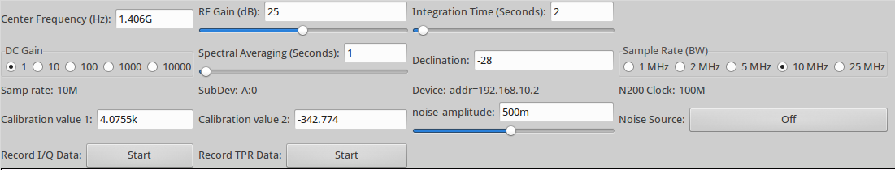
SDR-Based Radiometer Implementation
Introduction
Related Works
Background
Implementation
Experimental Results
Example Usage Scenario
Closing
SDR-Based Radiometer Graphical User Interface
Hardware Control
Data Display
Center Frequency
Bandwidth
Integration time
Raw total power
Calibrated noise temperature
Spectrum
Filtering
Notes:
The block shown is the TPR block we used in GNURadio. This combines the total power measurement and integration and low-pass filter into one block that we can call in other programs.

Slide 19
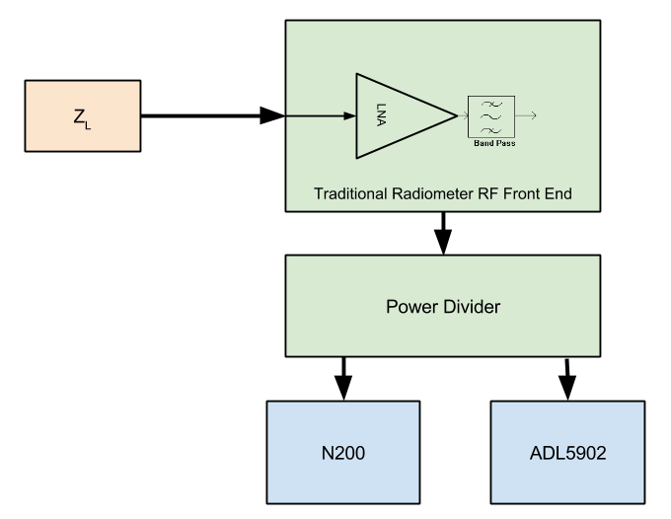
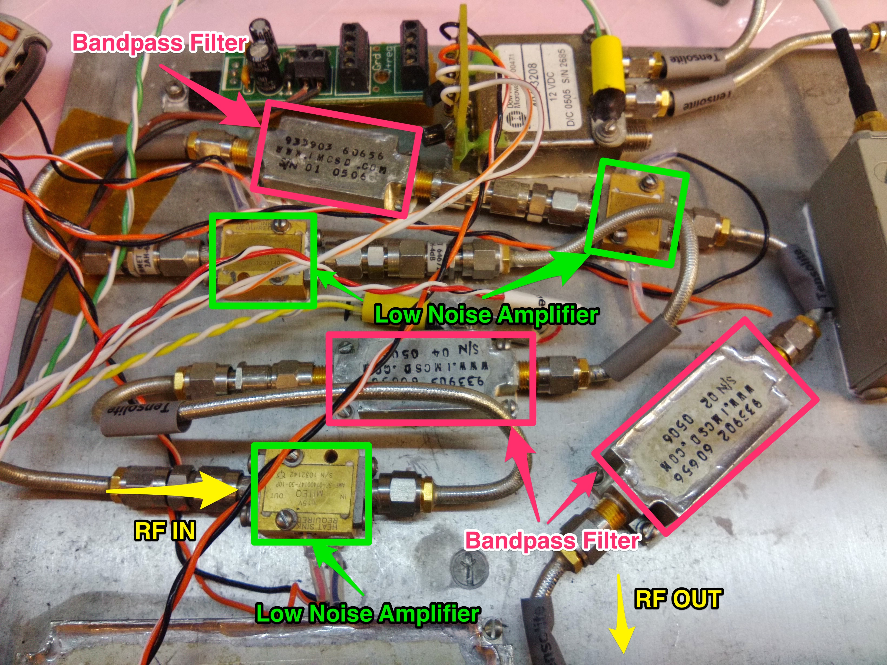
Experimental Results
Introduction
Related Works
Background
Implementation
Experimental Results
Example Usage Scenario
Closing
Experiment 1 – SDR-Based Radiometer Verification and Calibration
Setup
N200 SDR
ADL5902 - Square-law detector
Power Divider
Traditional Radiometer RF Front End
Matched Load
Data Collection
GNURadio
Labview with ADC
Notes:
The block shown is the TPR block we used in GNURadio. This combines the total power measurement and integration and low-pass filter into one block that we can call in other programs.

Slide 20
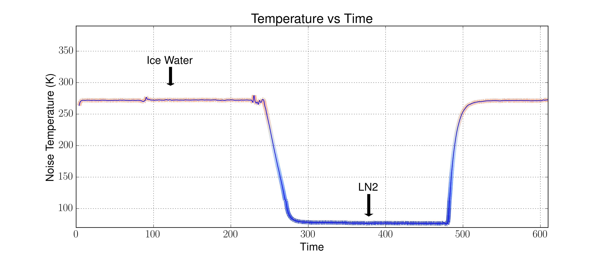
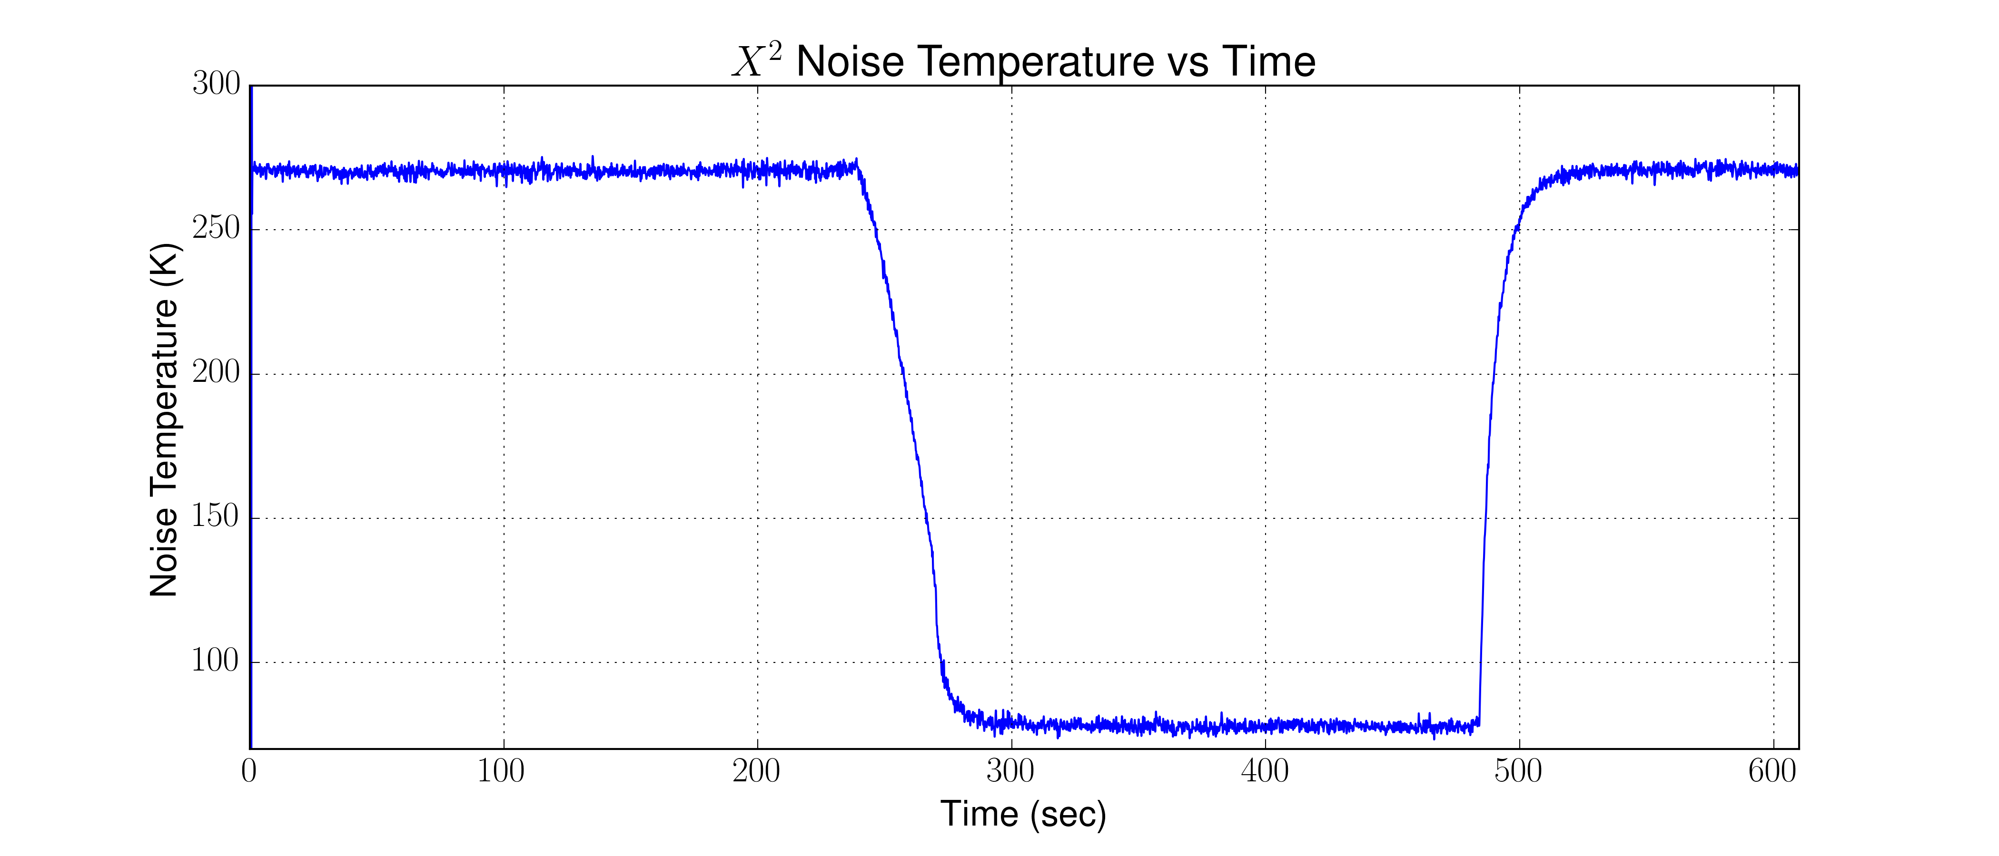
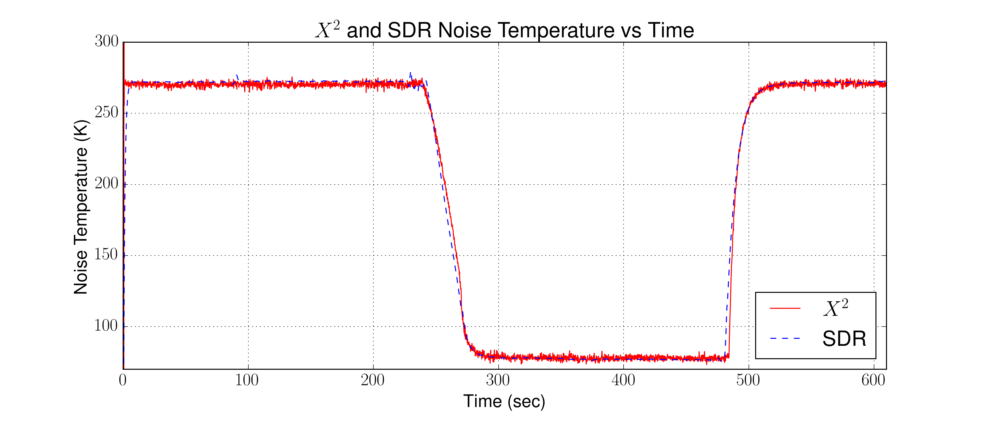
Experimental Results
Introduction
Related Works
Background
Implementation
Experimental Results
Example Usage Scenario
Closing
Experiment 1 – SDR-Based Radiometer Verification and Calibration
Results
Successfully calibrated both the square-law detector and the SDR-Based Radiometer
Notes:
This experiment was designed to verify that the SDR

Slide 21
Experimental Results
Introduction
Related Works
Background
Implementation
Experimental Results
Example Usage Scenario
Closing
Experiment 2 – Sensitivity and Stability
Setup
Identical Setup to Experiment 1
Notes:
The block shown is the TPR block we used in GNURadio. This combines the total power measurement and integration and low-pass filter into one block that we can call in other programs.

Slide 22
Experimental Results
Introduction
Related Works
Background
Implementation
Experimental Results
Example Usage Scenario
Closing
Experiment 2 – Sensitivity and Stability
Results
SDR-Based Radiometer met expected sensitivity and stability performance metrics
Sensitivity
Expected - .1 Kelvin
Measured - .23 Kelvin
Stability
Expected - +/- .5 Kelvin
Measured ~ +/- .15 Kelvin
Notes:
This experiment was designed to verify that the SDR

Slide 23
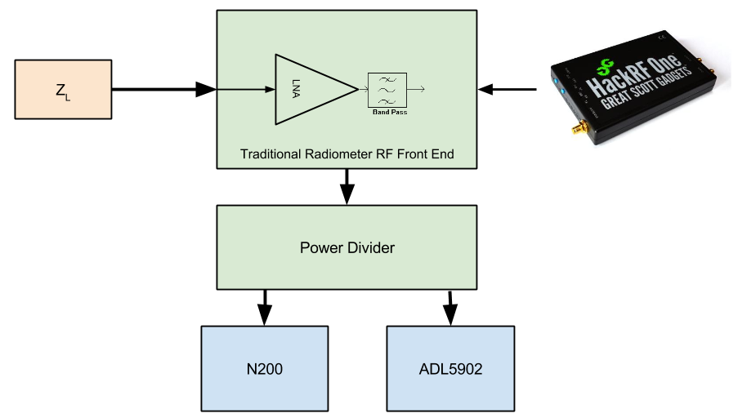
Experimental Results
Introduction
Related Works
Background
Implementation
Experimental Results
Example Usage Scenario
Closing
Experiment 3 – Interfering Signal Mitigation
Setup
Identical to Experiment 1 except an interfering signal is injected
Notes:
The block shown is the TPR block we used in GNURadio. This combines the total power measurement and integration and low-pass filter into one block that we can call in other programs.

Slide 24
Experimental Results
Introduction
Related Works
Background
Implementation
Experimental Results
Example Usage Scenario
Closing
Experiment 3 – Interfering Signal Mitigation
Results
SDR-Based Radiometer was able to successfully mitigate the interfering signal
Offending signal filtered
Total power measurements made
SDR-Based Radiometer
Analog Square-Law
Interfering signal identified
Notes:
This experiment was designed to verify that the SDR

Slide 25
Experimental Results
Introduction
Related Works
Background
Implementation
Experimental Results
Example Usage Scenario
Closing
Experiment 4 – Performance impact of interfering signal mitigation
Setup
Identical to Experiment 3
Notes:
The block shown is the TPR block we used in GNURadio. This combines the total power measurement and integration and low-pass filter into one block that we can call in other programs.

Slide 26
Experimental Results
Introduction
Related Works
Background
Implementation
Experimental Results
Example Usage Scenario
Closing
Experiment 3 – Interfering Signal Mitigation
Results
SDR-Based Radiometer was able to successfully mitigate the interfering signal
Total Power output vs bandwidth of signal
$$NEΔT vs Bandwidth (β)$$
𝑁𝐸Δ𝑇 𝑣𝑠 𝐵𝑎𝑛𝑑𝑤𝑖𝑑𝑡ℎ (𝛽)
Notes:
This experiment was designed to verify that the SDR

Slide 27
Example Usage Scenario
Introduction
Related Works
Background
Implementation
Experimental Results
Example Usage Scenario
Closing
Application Scenario: Soil Moisture reading with interfering signal
A radiometer is deployed in a field to take soil moisture readings
Data is recorded with the SDR-based radiometer. Both total power and the I and Q data is saved
After the experiment, the data is examined. The data is inconsistent and indicates a problem. Further analysis is needed

Slide 28
Example Usage Scenario
Introduction
Related Works
Background
Implementation
Experimental Results
Example Usage Scenario
Closing
The I/Q data is played back and examined on the spectrum analyzer window of our program. An interfering signal can clearly be seen at 1.406 GHz
A filter is designed in GNURadio to notch out the offending signal

Slide 29
Example Usage Scenario
Introduction
Related Works
Background
Implementation
Experimental Results
Example Usage Scenario
Closing
The data needs to be re-calibrated since we have lost some bandwidth to the filter
The experiment is played back through GNURadio but with the filter turned on
New total power measurements are then made resulting in the correct data obtained

Slide 30
Closing
Introduction
Related Works
Background
Implementation
Experimental Results
Example Usage Scenario
Closing

Slide 31
Closing
Introduction
Related Works
Background
Implementation
Experimental Results
Example Usage Scenario
Closing

Slide 32
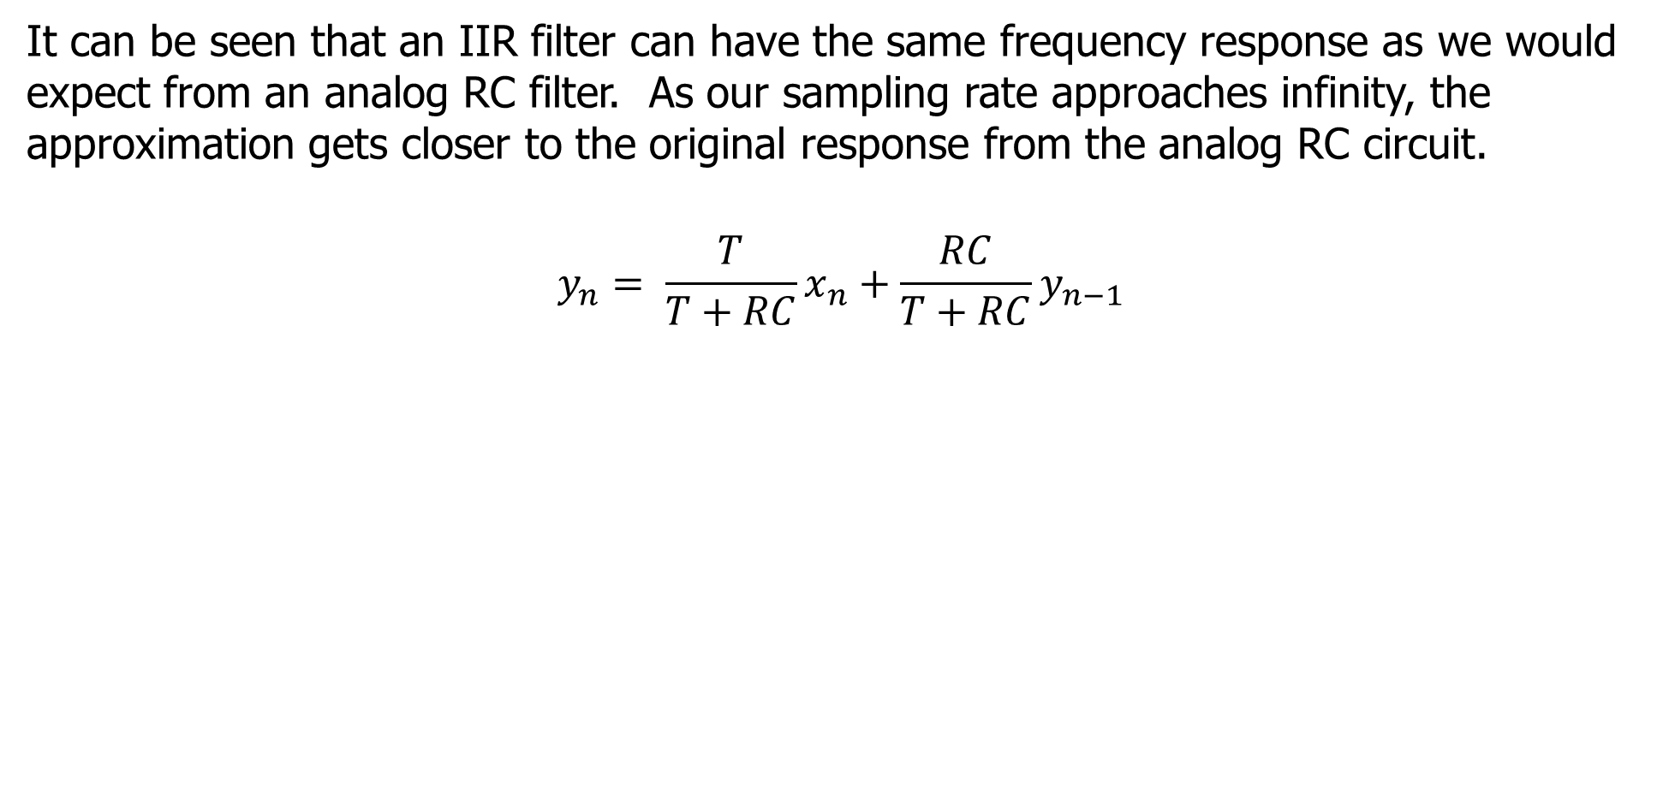
IIR as an integrator implementation
Introduction
Related Works
General Radiometer Theory
Software Defined Radio Theory
Experimental Results
Closing
It can be seen that an IIR filter can have the same frequency response as we would expect from an analog RC filter. As our sampling rate approaches infinity, the approximation gets closer to the original response from the analog RC circuit.
$$y_{n}= \frac{T}{T+RC}x_{n}+\frac{RC}{T+RC}y_{n−1}$$

Slide 33
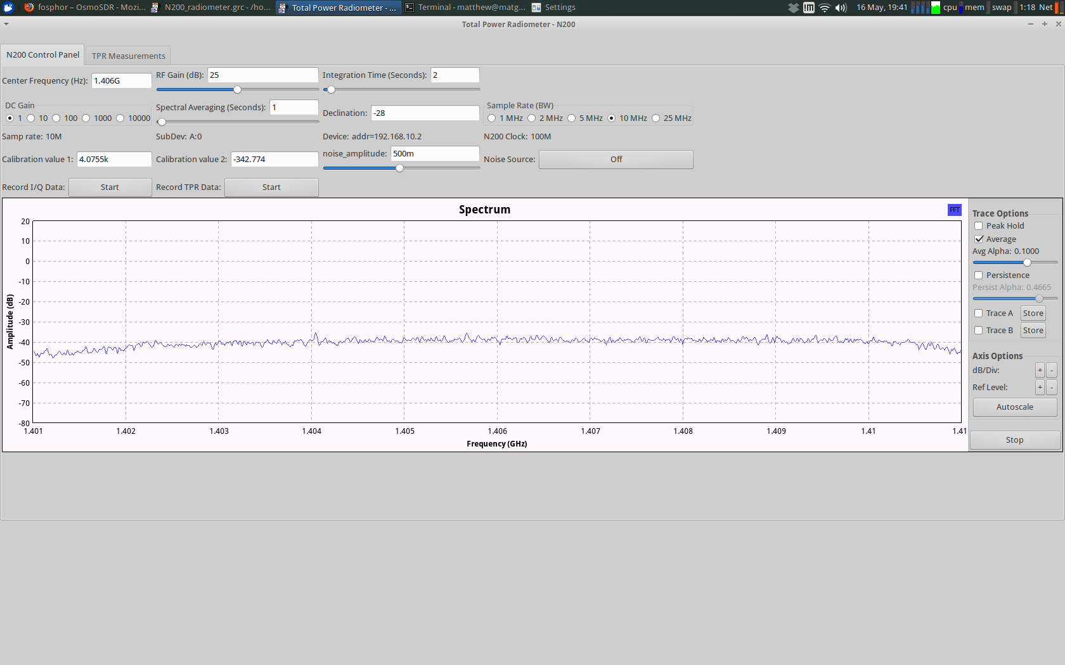
GUI for Radiometer
Introduction
Related Works
General Radiometer Theory
Software Defined Radio Theory
Experimental Results
Closing

Slide 34
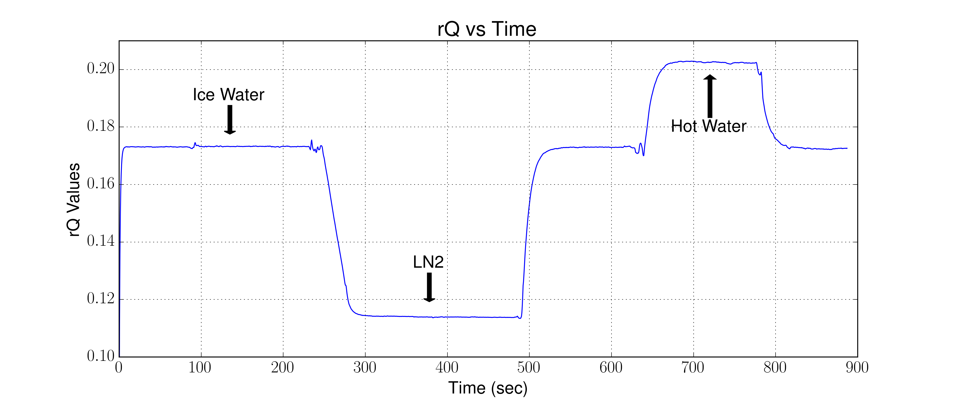
Experiment 1 – Normal Operation
Introduction
Related Works
General Radiometer Theory
Software Defined Radio Theory
Experimental Results
Closing
Let’s begin by looking at the software defined radio, and we will look for now at the rQ values recorded.

Slide 35
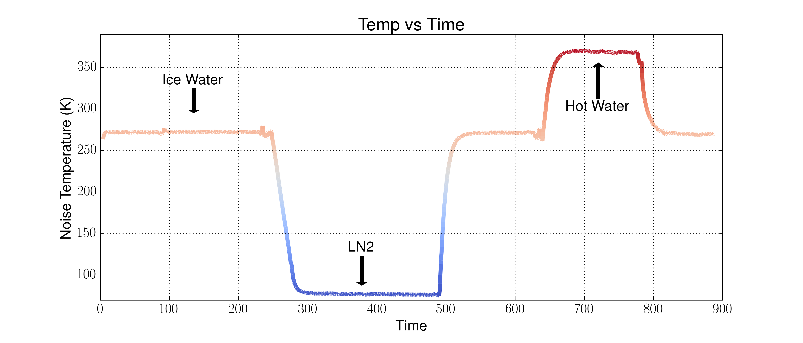
Experiment 1 – Normal Operation
Introduction
Related Works
General Radiometer Theory
Software Defined Radio Theory
Experimental Results
Closing
This data is not calibrated, since we have at least two points, we can calibrate this.

Slide 36
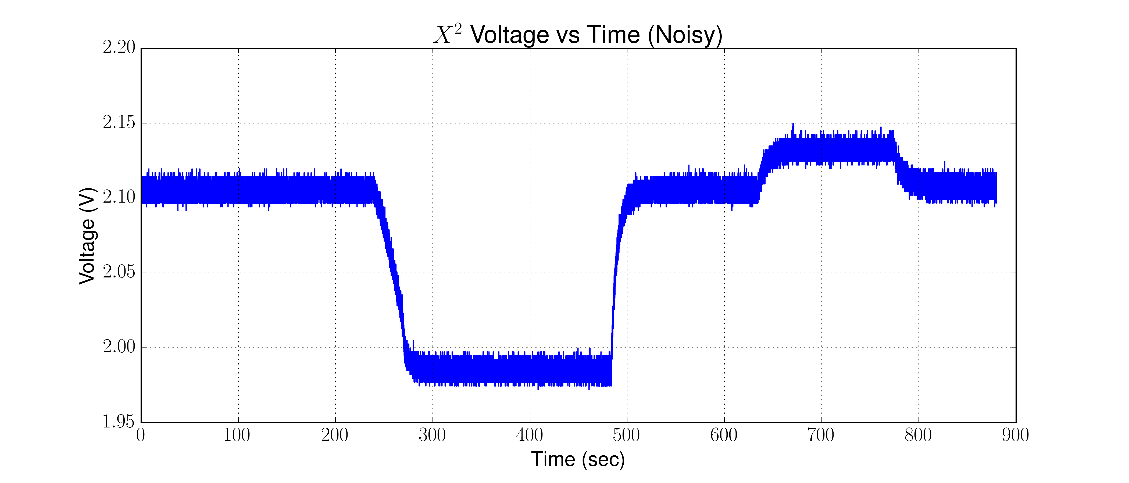
Experiment 1 – Normal Operation
Introduction
Related Works
General Radiometer Theory
Software Defined Radio Theory
Experimental Results
Closing
The SDR appears to be making correct measurements, but let’s look at the square-law

Slide 37
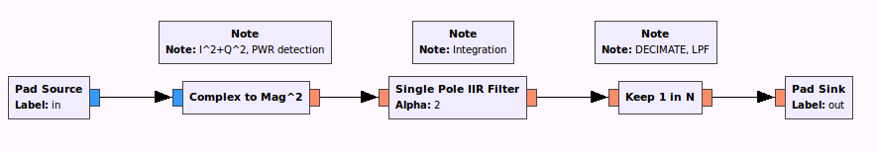
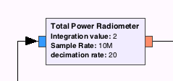
Implementation in SDR
Introduction
Related Works
General Radiometer Theory
Software Defined Radio Theory
Experimental Results
Closing
Power Detection
Integration
Low Pass Filter

Slide 38
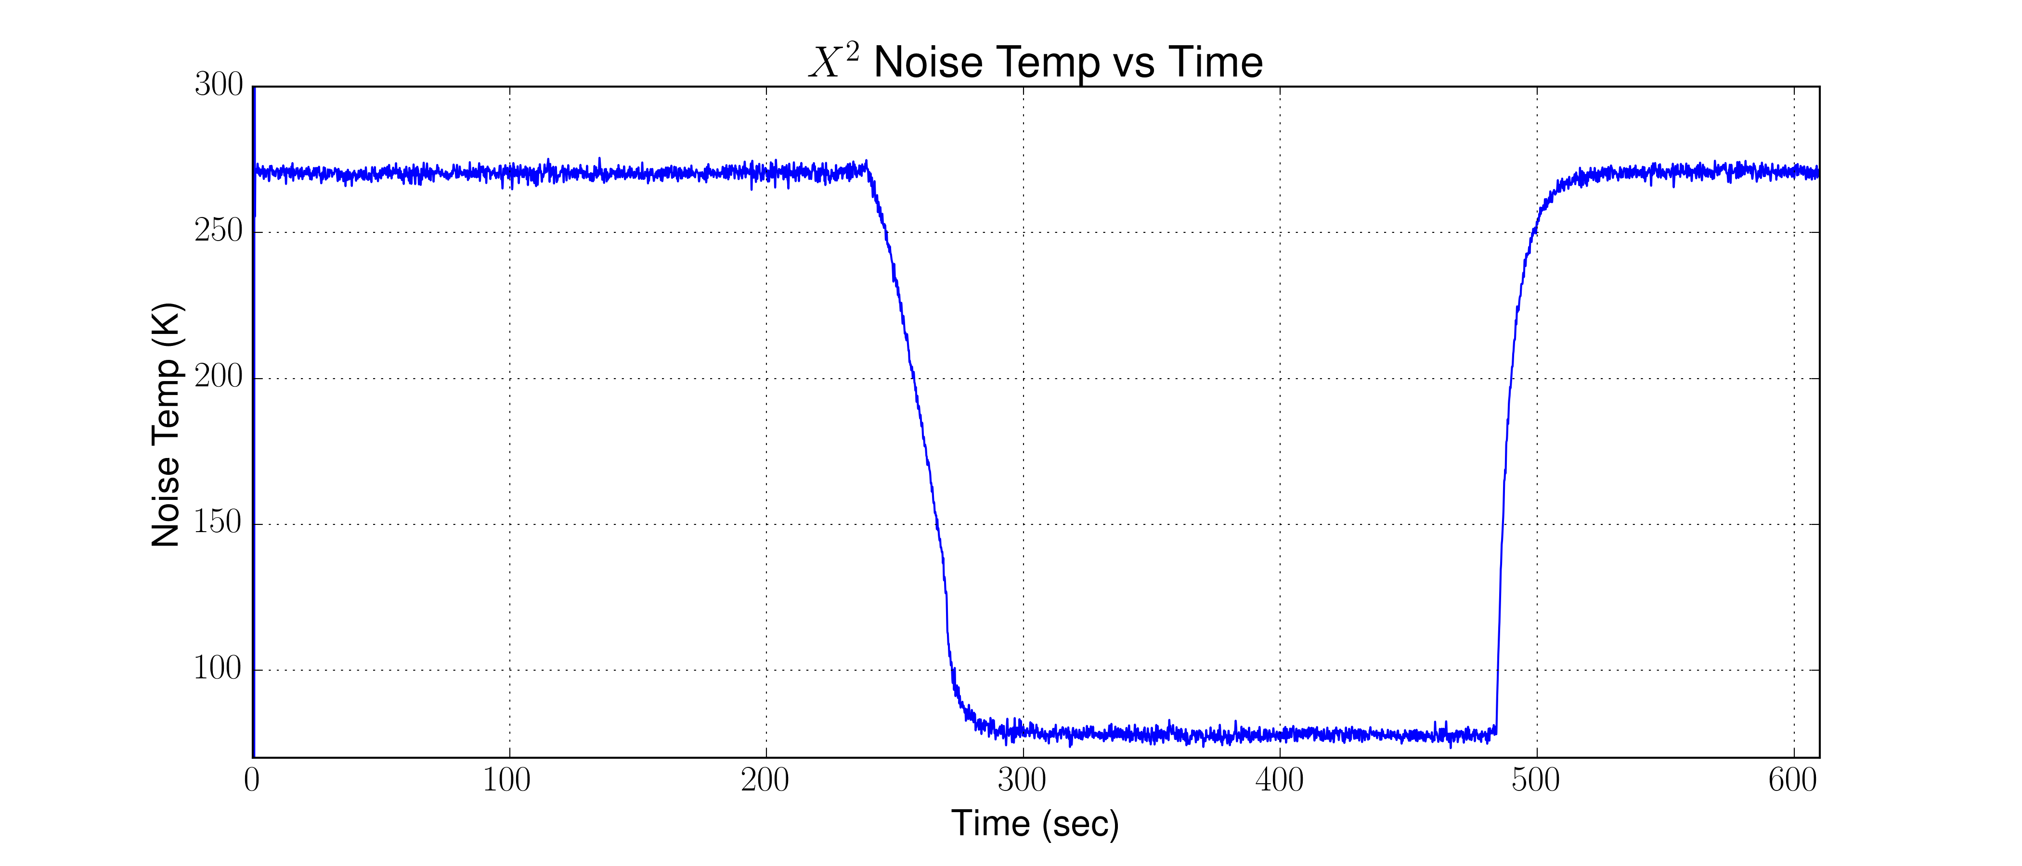
Experiment 1 – Normal Operation
Introduction
Related Works
General Radiometer Theory
Software Defined Radio Theory
Experimental Results
Closing
The square-law is pretty noisy. However, we can apply a low pass filter to our data and also calibrate it.

Slide 39
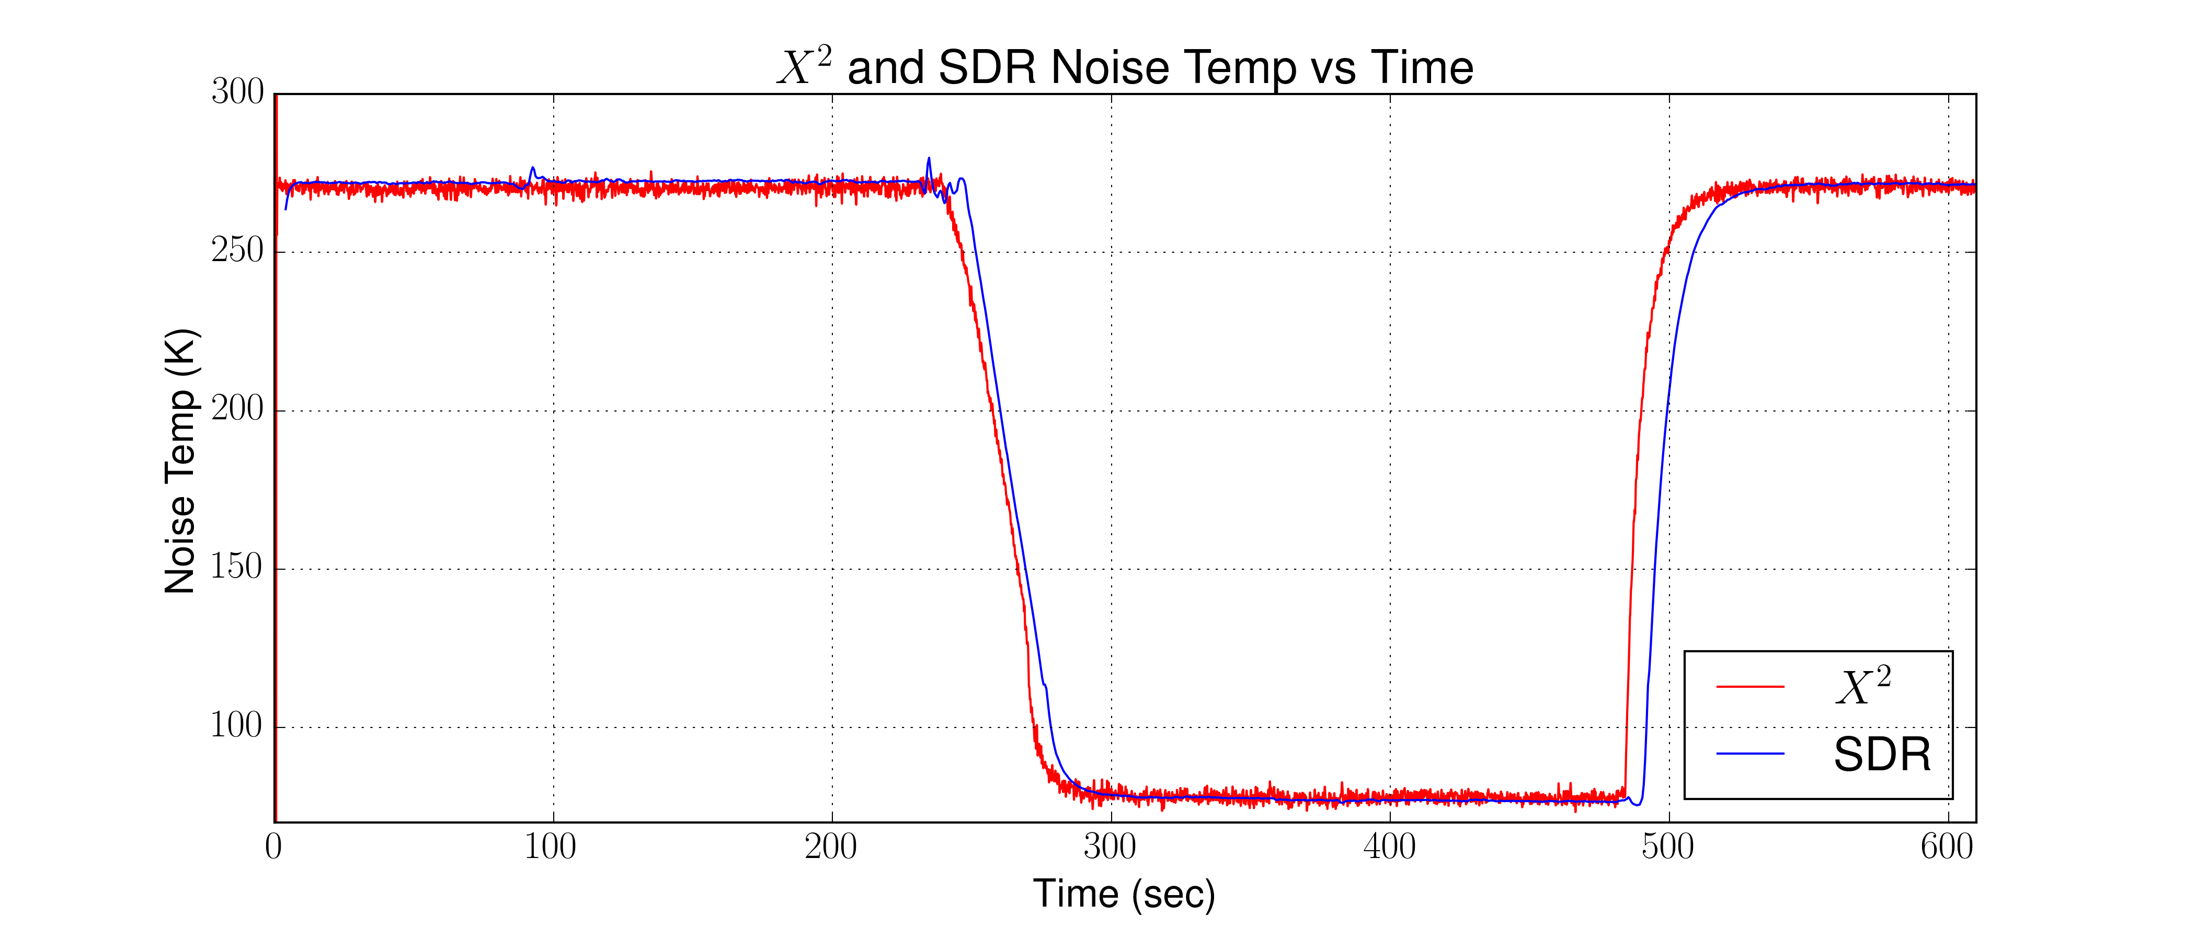
Experiment 1 – Normal Operation
Introduction
Related Works
General Radiometer Theory
Software Defined Radio Theory
Experimental Results
Closing
Again, this looks good, but let’s put them one on top of each other to verify

Slide 40
Experiment 1 – Normal Operation
Introduction
Related Works
General Radiometer Theory
Software Defined Radio Theory
Experimental Results
Closing
Experiment one verified that once calibrated, both the software defined radio and the square-law detector are in agreement. This shows that the SDR can indeed function as total power radiometer as we would expect from a traditional radiometer using a square-law detector

Slide 41
Experiment 1 – Normal Operation
Introduction
Related Works
General Radiometer Theory
Software Defined Radio Theory
Experimental Results
Closing
Let’s now look if we calibrated to soil moisture reading. Since we are not using an antenna, we can not look at a real sample. However, we can pretend using our calibration points. This also brings up another feature of the SDR, the waterfall display that can also give us a visual of the signal we are looking at.

Slide 42
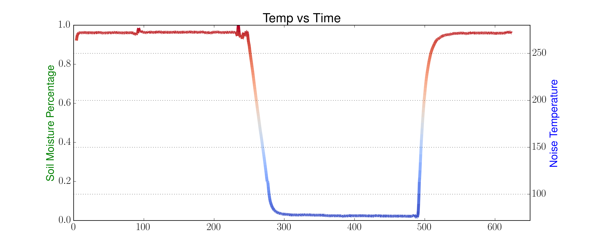
Experiment 1 – Normal Operation
Introduction
Related Works
General Radiometer Theory
Software Defined Radio Theory
Experimental Results
Closing
Let’s begin with saying that LN2 will be our “wet” or have a cooler noise temperature and our ice water will be our “dry” or warmer noise temperature.

Slide 43
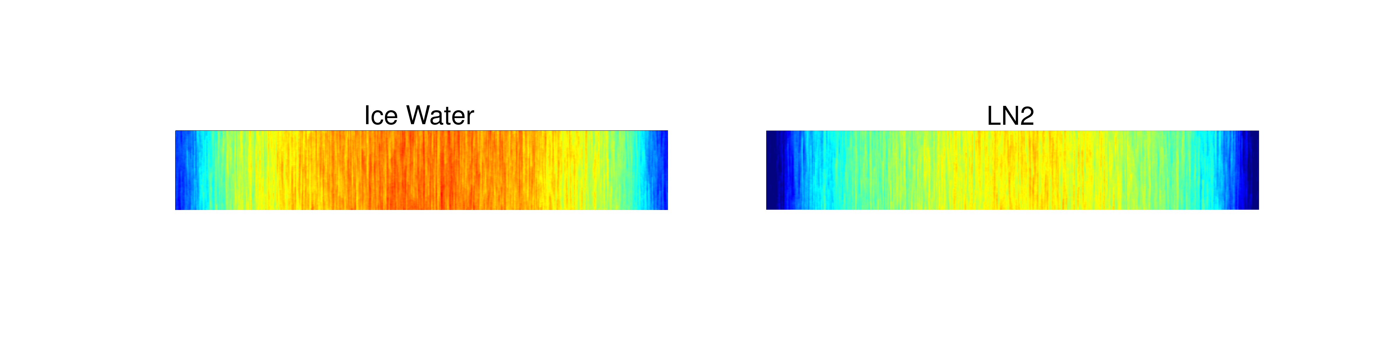
Experiment 1 – Normal Operation
Introduction
Related Works
General Radiometer Theory
Software Defined Radio Theory
Experimental Results
Closing
Another visual aid is the waterfall display that is part of GNURadio. Let’s look at the same data with the waterfall display.
We can see the “warmer” noise temperature in the ice water on the left and the “cooler” noise temperature with the LN2 on the right

Slide 44
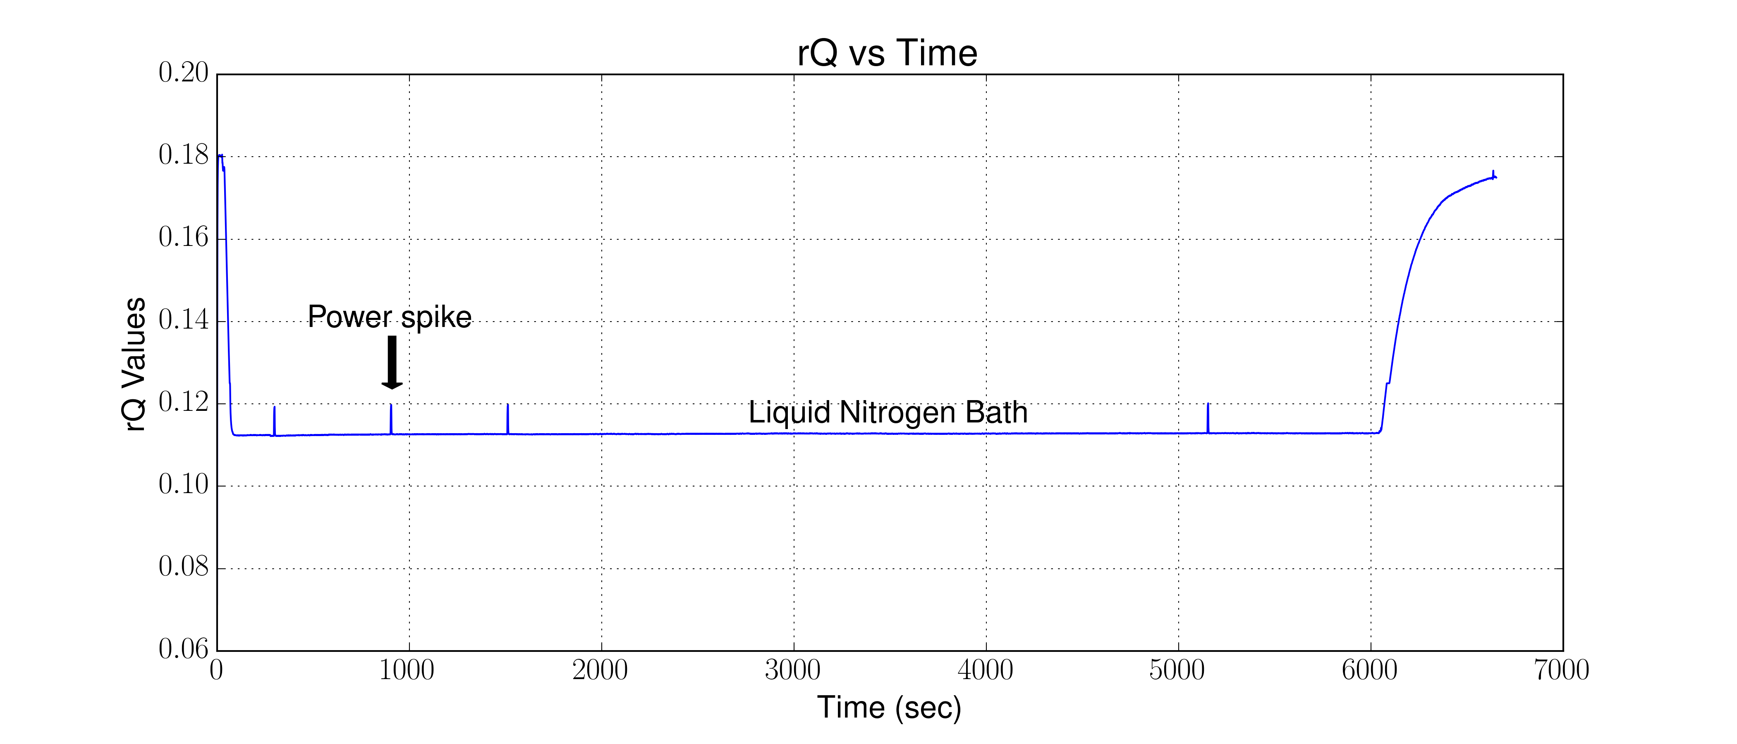
Experiment 2 – Stability
Introduction
Related Works
General Radiometer Theory
Software Defined Radio Theory
Experimental Results
Closing
Another test for the radiometer is looking at the stability of the system. Most of the stability we are concerned with falls with the LNAs that we use. However, we want to verify our system is stable with the addition of the SDR now.

Slide 45
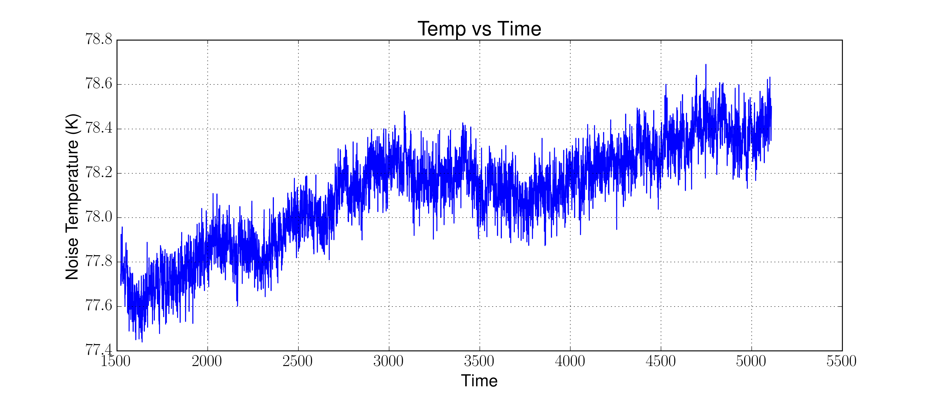
Experiment 2 – Stability
Introduction
Related Works
General Radiometer Theory
Software Defined Radio Theory
Experimental Results
Closing
To avoid some of the “spikes” we will choose a 62 min block that was error free.

Slide 46
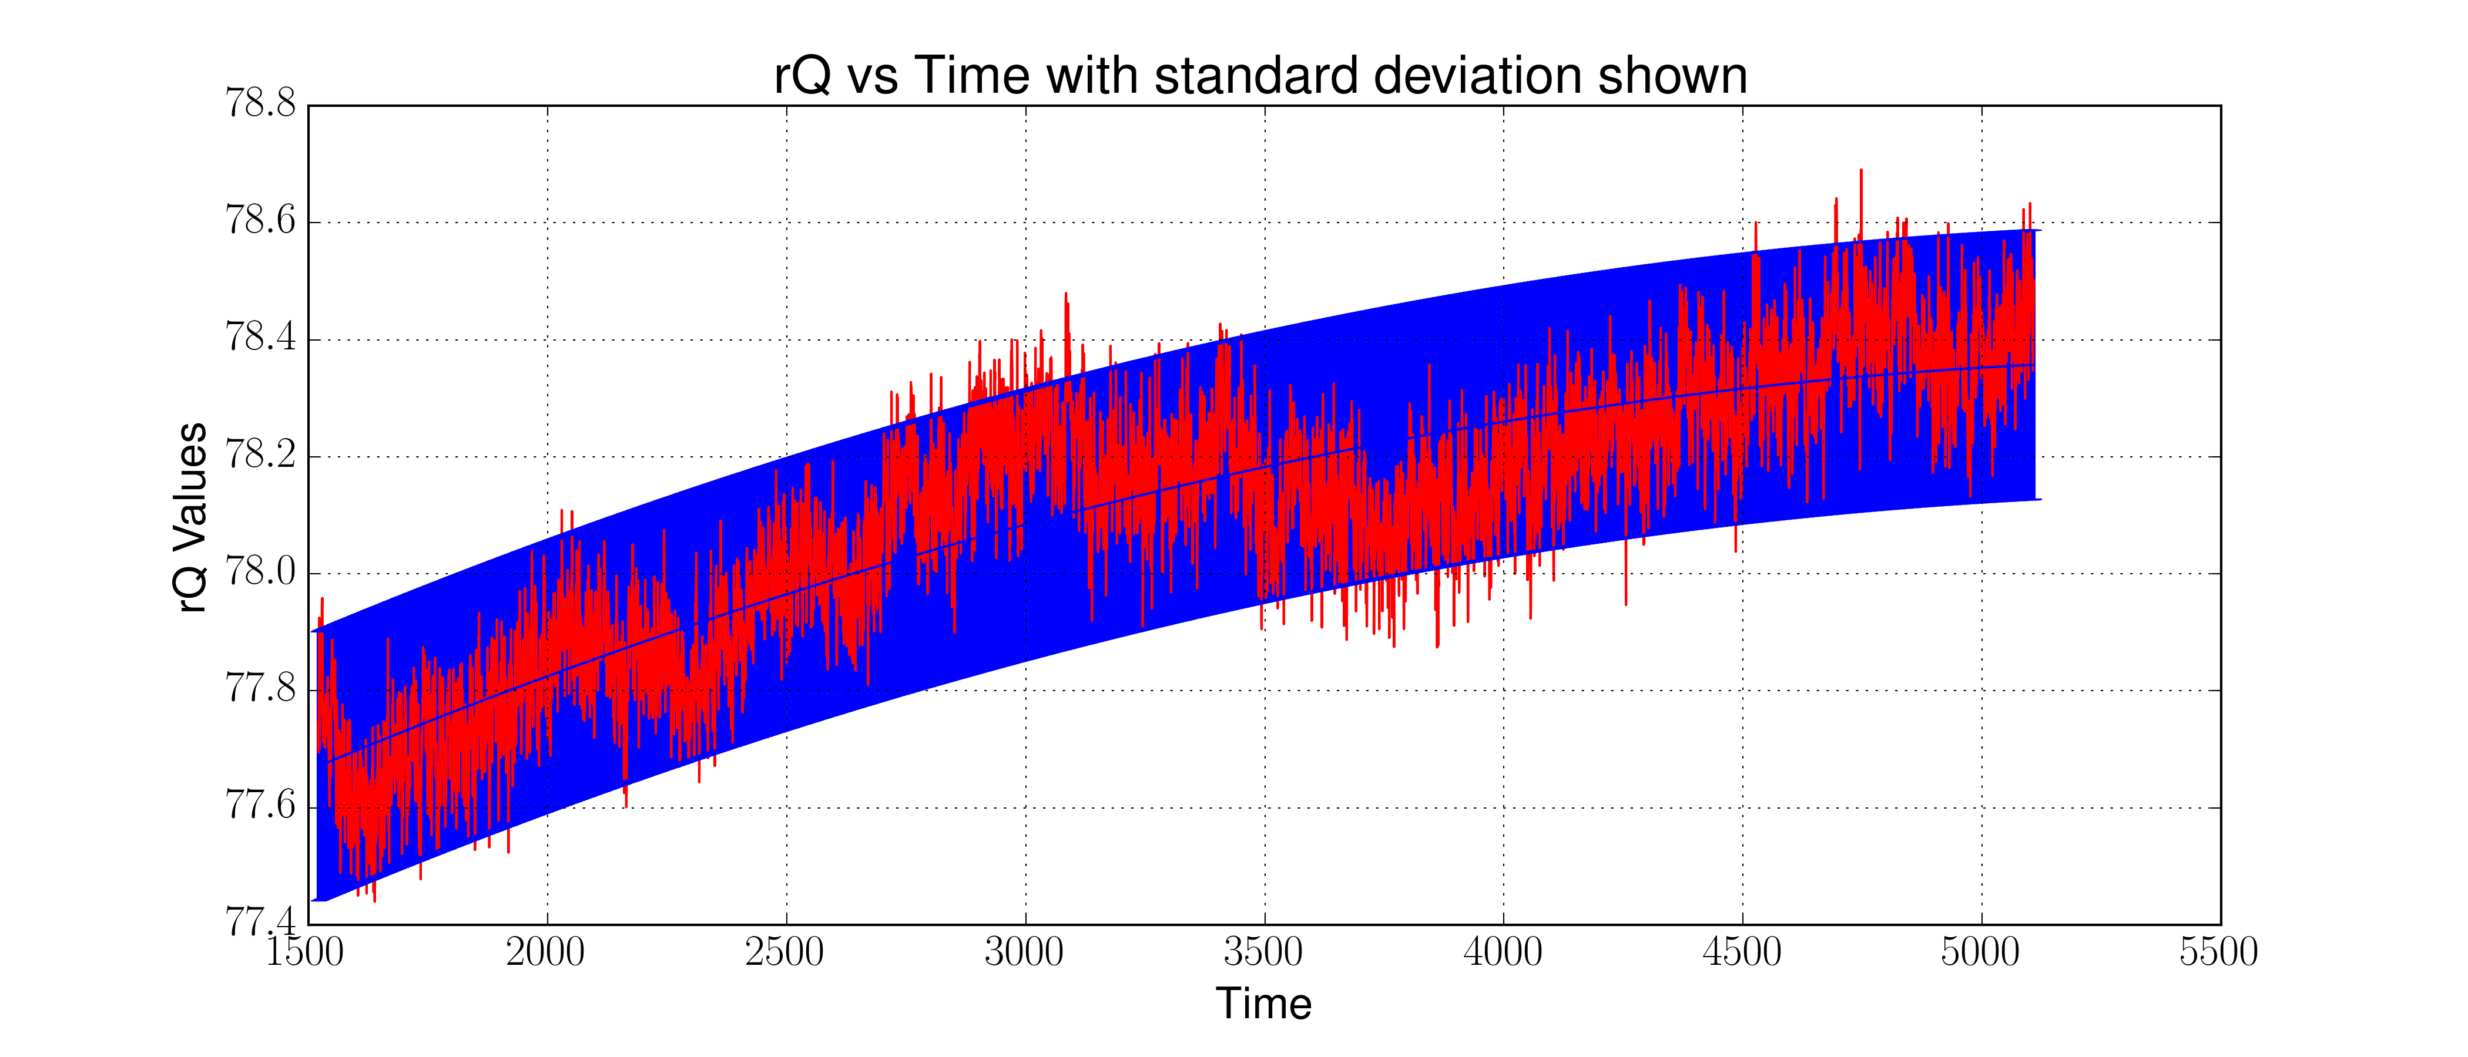
Experiment 2 – Stability
Introduction
Related Works
General Radiometer Theory
Software Defined Radio Theory
Experimental Results
Closing
We found by doing a standard deviation that we did not change more than .23 K and over the period of time we had a total change of .8 K

Slide 47
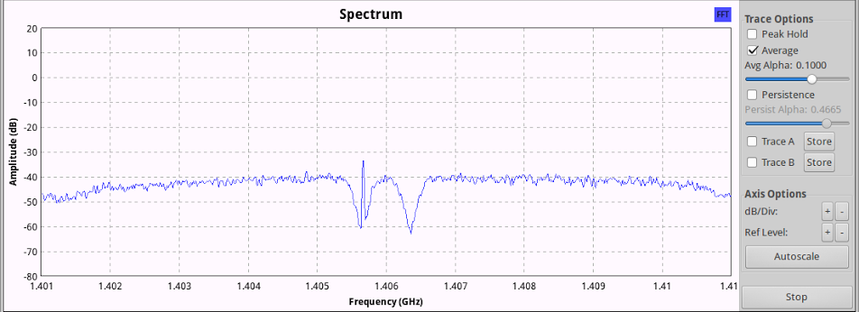
Experiment 3 – Noise Rejection
Introduction
Related Works
General Radiometer Theory
Software Defined Radio Theory
Experimental Results
Closing
In Experiment three we wanted to do something that would prove an advantage of the SDR over a traditional radiometer. A traditional radiometer does not have any methods to mitigate interference since it loses frequency information. With the SDR, we keep the frequency information and we can identify an remove an offending signal

Slide 48
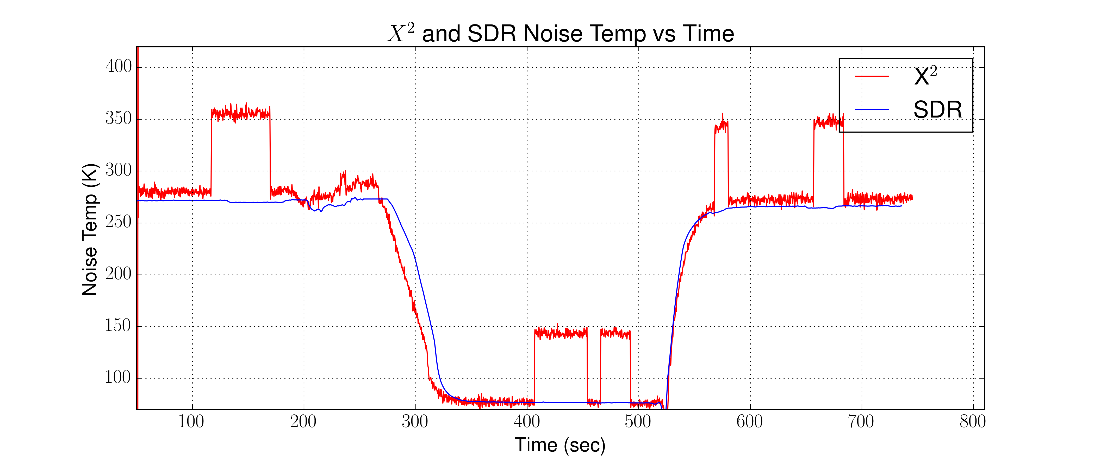
Experiment 3 – Noise Rejection
Introduction
Related Works
General Radiometer Theory
Software Defined Radio Theory
Experimental Results
Closing
Here we can both the SDR and square-law on top of each other again. However, the SDR is filtering the offending signal.

